Slide 1
Advanced Data Modeling
Vijay Dialani
Boise State University
Special Thanks to Pearson’s Publishing for use of their instructional material

Slide 2
References
For self study, please refer to:
Chapter 3 and 4 from 5th Edition
Chapter 7 and 8 from 6th Edition

Slide 3
Revision: Company Data Model

Slide 4
Relation Types – Ternary Relation

Slide 5
Expressing Ternary Relations as Binary Relations

Slide 6
In-Class Exercise
Design an ER schema for keeping track of information about votes taken in the U.S. House of Representatives during the current two-year congressional session.
The database needs to keep track of each U.S. State’s Name (e.g., Texas, New York, California) and includes the Region of the State (domain is {Northeast, Midwest, Southeast, Southwest, West}).
Each congressperson in the House of Representatives is described by their Name, and includes the District represented, the StartDate when they were first elected, and the political Party they belong to (domain is {Republican, Democrat, Independent, Other}).
The database keeps track of each Bill, and includes the BillName, the DateOfVote on the bill, whether the bill PassOrFailed (domain is {Yes, No}), and the Sponsor (the congressperson(s) who sponsored the bill).
The database keeps track of how each congressionperson voted on each bill (domain is {Yes, No, Abstain, Absent}). Draw an ER schema diagram for the above application. State clearly any assumption you make.

Slide 7
Specialization of Entity Type

Slide 8
Specialization Of Instances

Slide 9
Generalization

Slide 10
Attribute based Specialization

Slide 11
Non disjoint specialization

Slide 12
Specialization with shared subclass

Slide 13
Multiple Inheritance

Slide 14
Union Types

Slide 15
Example EER

Slide 16
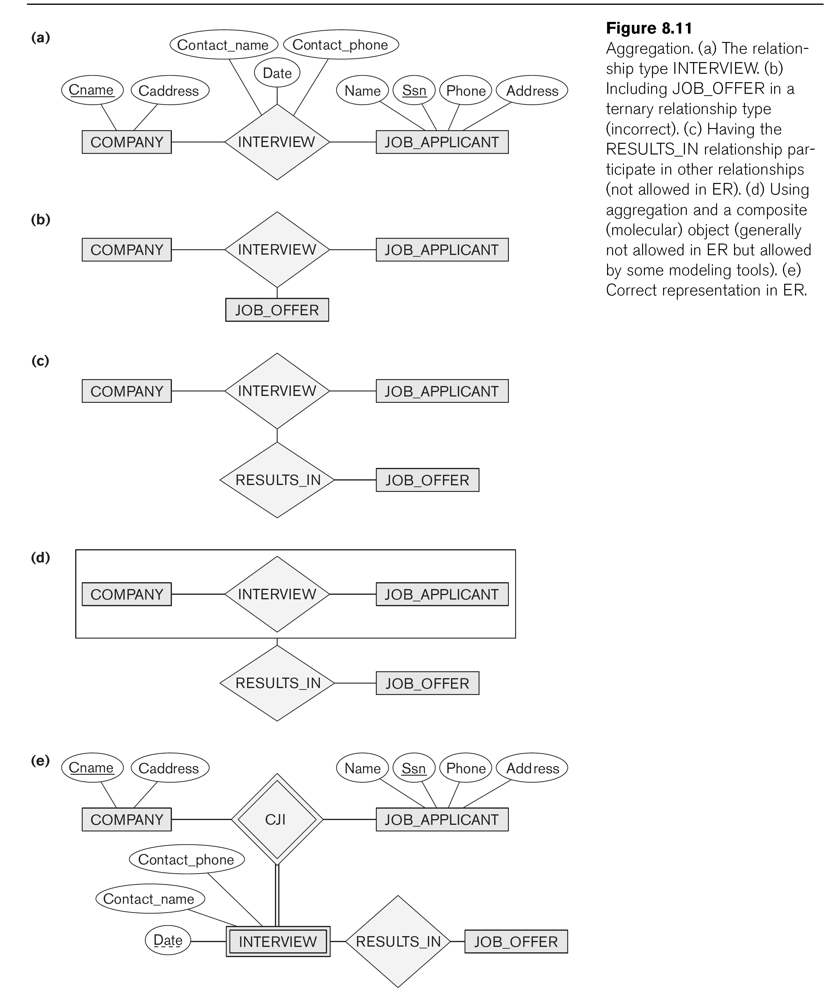
Miscellaneous

Slide 17
Miscellaneous

Slide 18
Questions and Answer

